Slide 1

Setting new quality standards for both holes and electrons in ultra-high mobility GaAs quantum wells
This talk is our thank you for NAMBE’s honoring our MBE Group with the Art Gossard MBE Innovator Award.
We will focus here on the innovations to our MBE-technique that have allowed us to achieve a long series of high and higher quality levels in GaAs growth.
Loren Pfeiffer,
Ken West, Kirk Baldwin, A. Gupta, Edwin Chung Princeton University, Princeton, New Jersey
NAMBE-2023:
Art Gossard MBE Innovator Award Lecture
Madison, Wisconsin

Slide 2
Some History:
I first interacted with Art Gossard in May 1987. We were both Members of Technical Staff at Bell Labs in Murray Hill, NJ.
Art had just accepted a faculty position at UC-Santa Barbara. He had recently achieved a new world-record mobility for electrons in a GaAs Quantum well at 5 million cm²/Vs using a new MBE machine that he had purchased from Varian Corporation.
Bell Labs management wanted their MBE effort at Murray Hill to continue, so they asked me if I wanted to try to become an MBE-grower using the Varian machine that Art had purchased.
In May and June Art taught me the rudiments of MBE growth! My lab assistant, Ken West, and I asked many questions, and Art and his assistant, John English, were both very generous with their answers and gracious with their help.
But by July both Art and John English had left Bell Labs and were off to Santa Barbara. And by September it became clear that the Varian machine was running out of Arsenic source material, and would have to be opened-up for servicing.

Slide 3
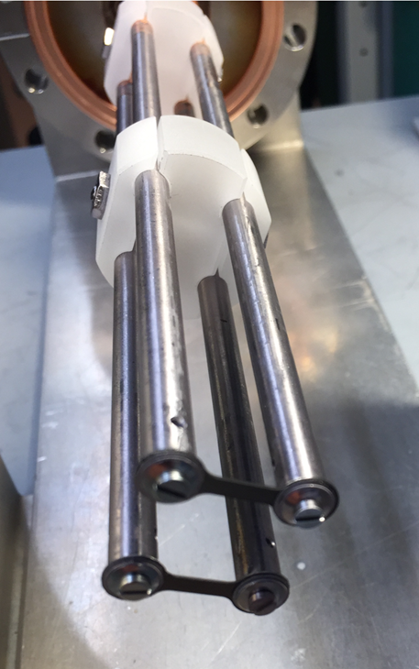
That first open-up of the Varian machine lasted six months. Ken West and I made 12 changes to the machine. Of these 12 “innovations”, I believe four were positive, seven were minor, and one was a disaster!
Let’s discuss:
Innovation #1: A new type of Si-doping cell.
MOST Si-doping cells feature Si heated in a PBN crucible. But the hot PBN crucible and K-cell outgas impurities.
In our innovation the Si-dopant flux comes from a free-standing Si single-crystal hot-filament heated by electric current passing through massive tantalum supporting rods.
Because the Ta-rods are massive, they stay cool. The only hot area is at the thin center span of the single-crystal Si-filament.
I believe this new type Si-doping cell was largely responsible for the 11 million electron mobility record in GaAs that we set in 1989.

Slide 4
Innovation #2: We replaced the Viton-sealed vacuum valves with All-metal vacuum gate-valves.
Viton seals are a type of rubber sealing O-ring.
1. Viton cannot be baked at high temperatures, and 2. Viton outgasses organic impuries into the MBE environment.
The Swiss company VAT makes All-Metal Gate Valves that are reliable but expensive.
These All-Metal VAT-Gate Valves substantially reduced the load of organic impurities in the pristine MBE environment.

Slide 5
Innovation #3: Replacing the (400 l/s) Ion pump that came with the Varian machine with two UHV-cryopumps, (each 3000 l/s).
To handle any interruptions in electrical service to the cryopumps, we built circuits to detect cryopump-warming, and to seal off the warming-cryopumps from the MBE environment.
However, during a long power interruption, a sealed-and-warming cryopump can become a dangerous bomb!
To minimize this risk, we installed high-capacity backup batteries, a diesel powered electrical backup, and a robotic telephone dialer, that would notify us 24hrs/day of such an emergency.
The effort to construct these extensive backup systems was rewarded with a fifteen times gain in vacuum-pumping-speed.
  Innovations #2 and #3 togteher lowered our base pressure from 10⁻¹¹ Torr to the 10⁻¹² Torr vacuum range.

Slide 6
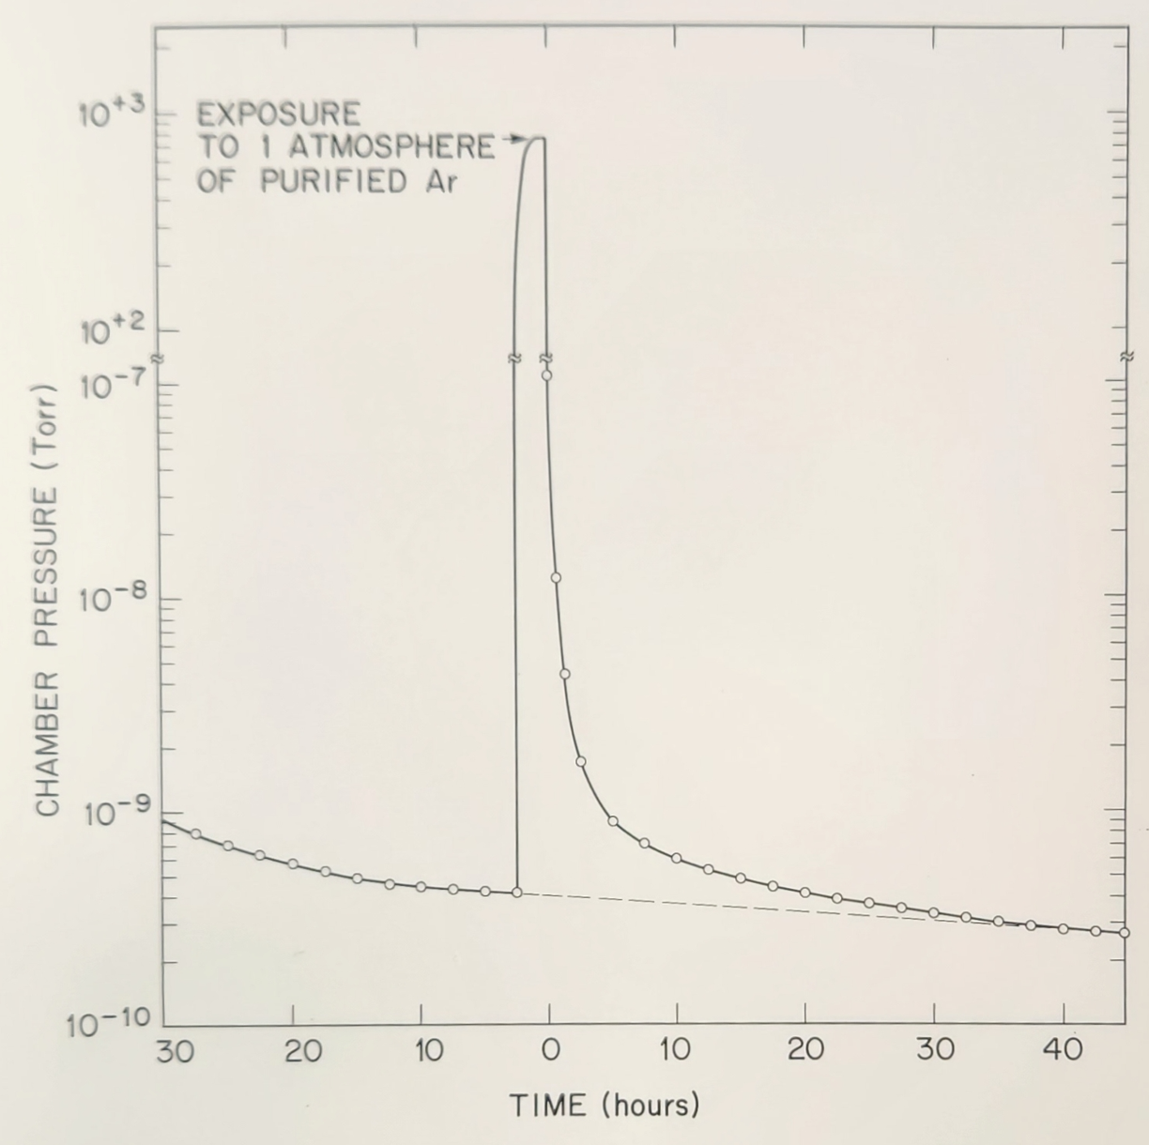
Innovation #4: Argon gas method for servicing the Ga, Al, or Si sources without exposing of the MBE chamber to air.
Even a brief exposure of a UHV vacuum system to New Jersey air deposits 10 to 20 molecular layers of H₂O, CO, and CO₂ on all internal surfaces.
Re-cleaning these surfaces would require a new bake of many hours!
As a test we pumped a vacuum chamber to 4x10⁻¹⁰ Torr. We then closed-off the cryopump and filled the chamber with an atmosphere of purified Argon gas.
When we pumped out the Ar-gas, we saw the chamber pressure quickly drop to the original level,
showing that Argon gas does not contaminate a clean vacuum chamber.

Slide 7
Innovation idea: Because Argon gas does not appear to contaminate surfaces, it can be used to protect the pristine conditions in fully-baked MBE chambers.
Innovation #4: Argon gas method for installing equipment without exposing the MBE chamber to air.
Flow 10⁻⁶ purity Argon over HOT Titanium to get 10⁻¹¹ purity Argon.
Fill the MBE machine with 10⁻¹¹ purity Argon (to 2 psi above an atmosphere).
Install a plastic glove-bag tightly over a new blank-off flange and the part to be exchanged. (for example an empty effusion cell)
Fill the glove-bag with purified Argon, then expel half the Argon gas-air mix through a one-way vent. Repeat these steps twenty-five times, until the glove bag contains 10⁻⁸ purity Argon gas (pressurized to one atmosphere).
Undo the flange-bolts on of the part to be replaced. There will be a slight gas outflow from the MBE into the glove bag as the Argon gas pressures equilibrate.
Remove the old part, and bolt on the blank-off flange in its place.
We have found that this procedure preserves the pristine conditions of a previously vacuum-baked MBE interior.
Our MBE machine interior has not seen New Jersey air since 2014!

Slide 8
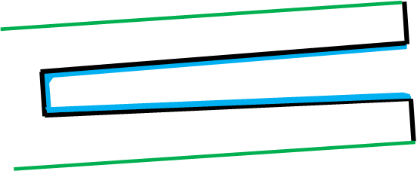
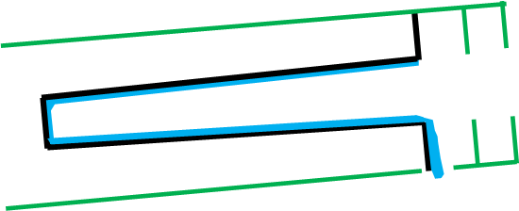
Example of a FAILED Innovation: We installed baffles to lower the radiation-load from the lip of a PBN crucible containing molten Aluminum.
Without thermal baffles the molten Al crawls forward but STOPS at the cold PBN lip.
With thermal baffles the molten Al crawls forward PAST the hot PBN lip DESTROYING the Al-Cell.
Molten Aluminum can destroy a HOT Tantalum K-Cell in fifteen minutes!

Slide 9
These innovations at Bell Labs in Murray Hill allowed us to gradually raise the GaAs quantum well mobility from 5 million cm²/Vs to 30 million cm²/Vs.
In 2009 we moved our MBE effort from Bell Labs to Princeton University and obtained a National Science Foundation Grant, and a series of Gordon and Betty Moore Foundation Grants to build a more innovative MBE machine.
By 2015 our new Princeton MBE machine was designed and built. It featured:
Four external cryopumps, each protected with a large metal-sealed gate valve,
which together have 3-times the pumping speed of our old Bell Labs machine,
And an innovation consisting of:
Three internal cryo-cooled 18K surfaces of large area in the MBE-sump
which together added hugely to the effective pumping speed.

Slide 10
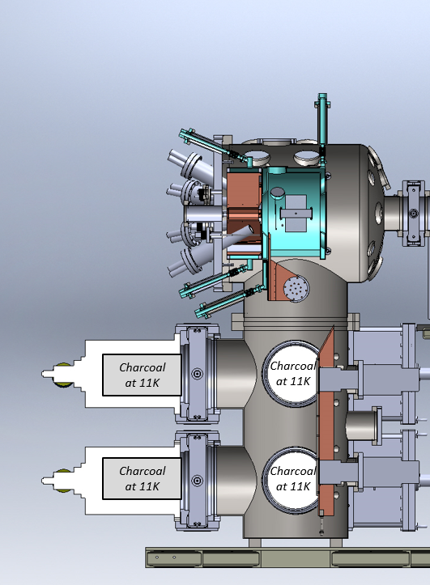
We installed novel 18K cryo-surfaces inside the vacuum-sump and growth-chamber when we built our MBE machine in 2015.
SolidWorks cut-away drawing of our Princeton MBE machine
Liquid-nitrogen cooled growth environment
Effusion cells pointing at the MBE substrate
MBE-substrate
18K cryo-finger in the MBE growth environment
Four external charcoal cryopumps at 11K
Large-area internal 18K cryo-finger in the vacuum-sump

Slide 11
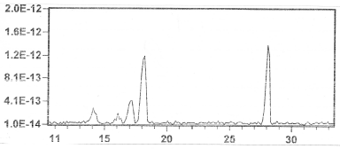
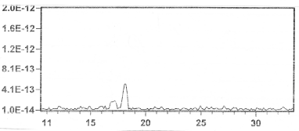
These internal 18K cryo-traps were a technical success in reducing the ambient background impurity levels as measured by an RGA in the vacuum sump.
CO or N₂
Impurity partial pressures at Residual Gas Analyzer with warm internal traps = 300K.
water
Nitrogen
Cooling the plates to 18K causes:
Oxygen
the N₂ and CO peaks to fall by factors of 10,
and the water peaks to fall by factors of 2.5.
Impurity partial pressures at Residual Gas Analyzer with cold internal traps
= 18K.
BUT Unfortunately, by themselves these 18K cryotraps did not improve our GaAs in terms of zero-field mobility in the years 2015 through 2018.

Slide 12
To improve our quantum well mobility we needed to solve another issue:
We needed a set of innovations to get a new insight:
The insight was to finally understand how the purity of the AlGaAs barriers near the quantum well relates to the electron-mobility of that well.
In 2017 our MBE machine and its gallium sources were clean from their use in a previous growth campaign, but we needed to install a new source of elemental aluminum that we suspected probably contained impurities.
We used these ‘clean Ga’ and ‘dirty Al’ sources to make a series of quantum wells, and measured their mobilities versus the thickness of an optional lower AlGaAs barrier.

Slide 13
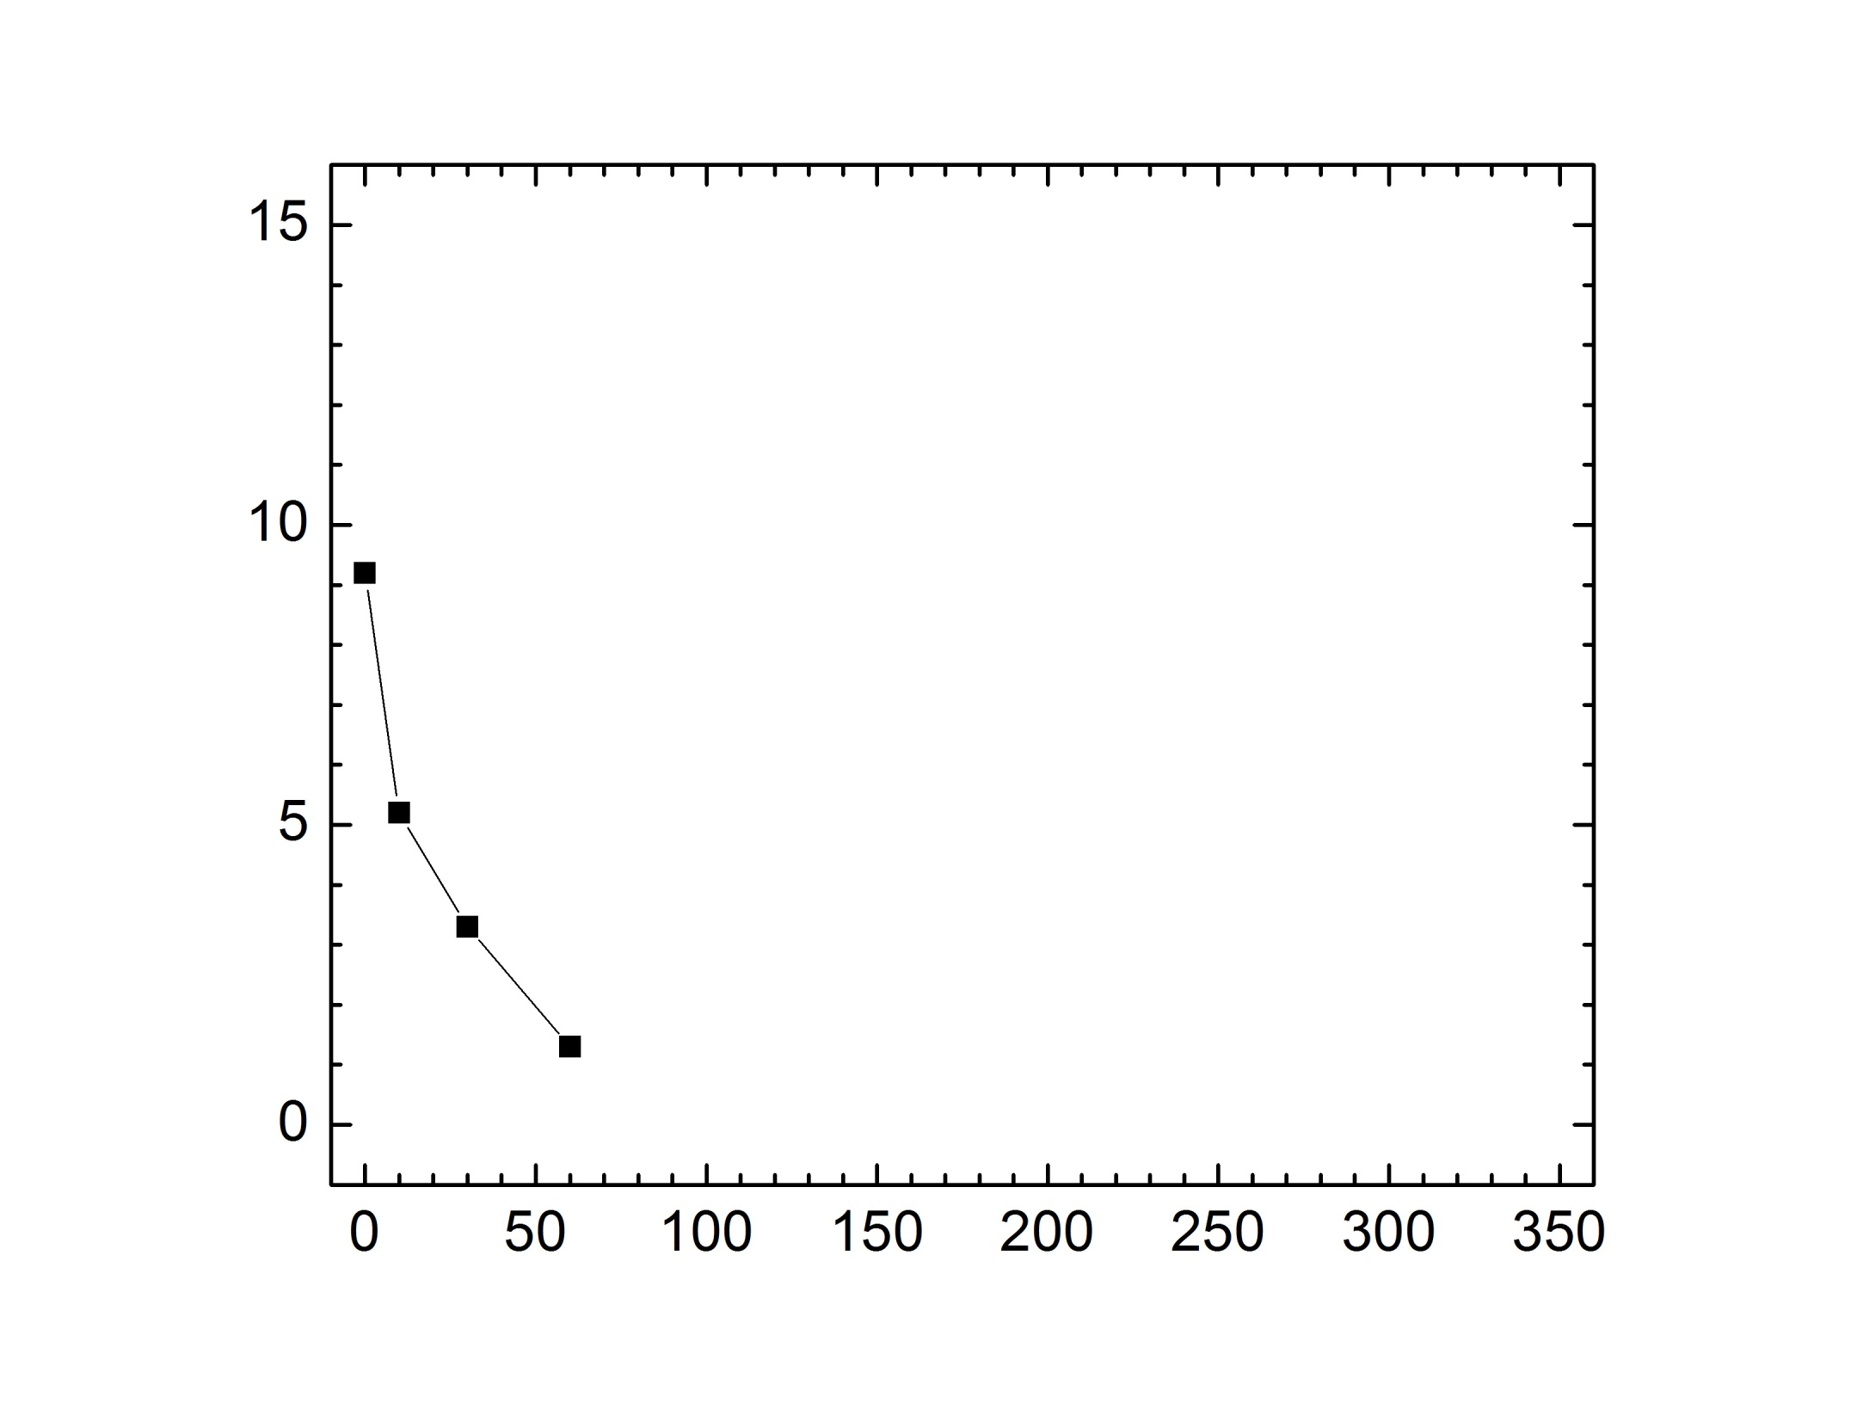
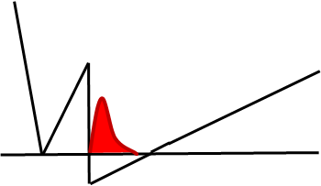
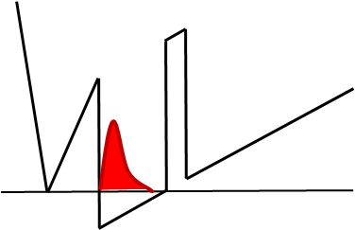
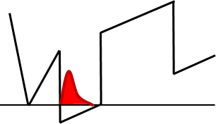
If we omited the optional lower barrier we saw 9 million 2D-mobility.
This was an excellent result with a new Al-charge.
Si-dopant
10nm AlGaAs
Si-dopant
Electron mobility (millions cm²/V sec)
Electron mobility (million cm²/V sec)
60nm
AlGaAs
But if our lower barrier was 60nm thick, we saw only 1 million-mobility.
This result is quite poor!
Si-dopant
Thickness of AlGaAs barrier below quantum well (nm)
Thickness of AlGaAs barrier below quantum well (nm)

Slide 14
Especially notice that as the thickness of the lower AlGaAs barrier increased, the Q-well mobility continued to fall.
Why would this happen?
10nm
As a clue remember:
Electron mobility (million cm²/V sec)
the direction of MBE-growth is from the lower barrier toward the quantum well
Electron mobility (millions cm²/V sec)
60nm
Thickness of AlGaAs barrier below quantum well (nm)
Thickness of AlGaAs barrier below quantum well (nm)

Slide 15
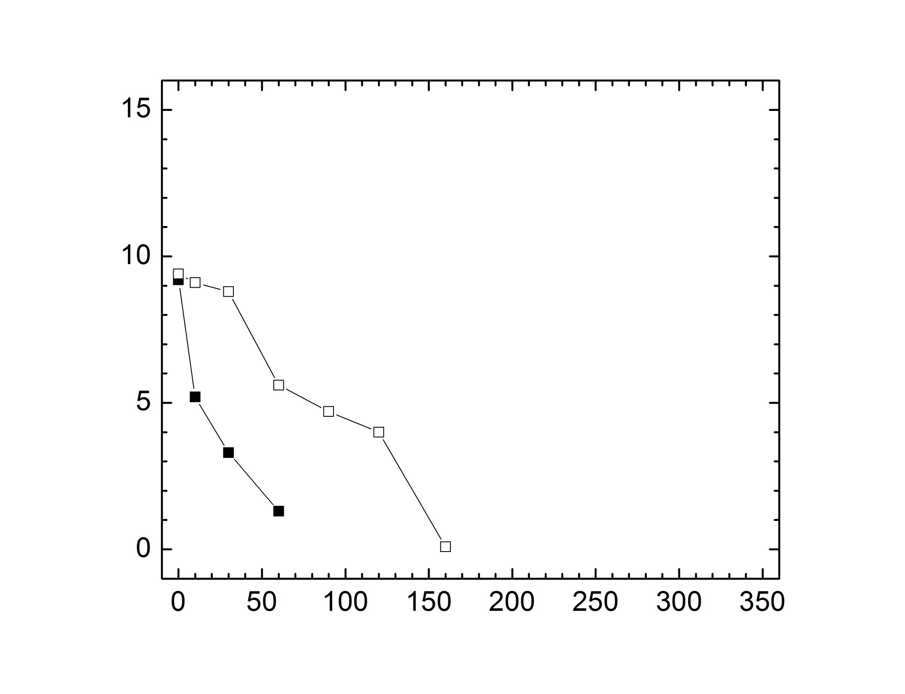
As the newly filled Al-cell was exercised, things got better. Baking the Al-cell offline for 200 hours at its run-temperature, caused the 60nm-lower-barrier mobility to rise from 1 million to 5.5 million.
Electron mobility (million cm²/V sec)
Thickness of AlGaAs barrier below quantum well (nm)

Slide 16
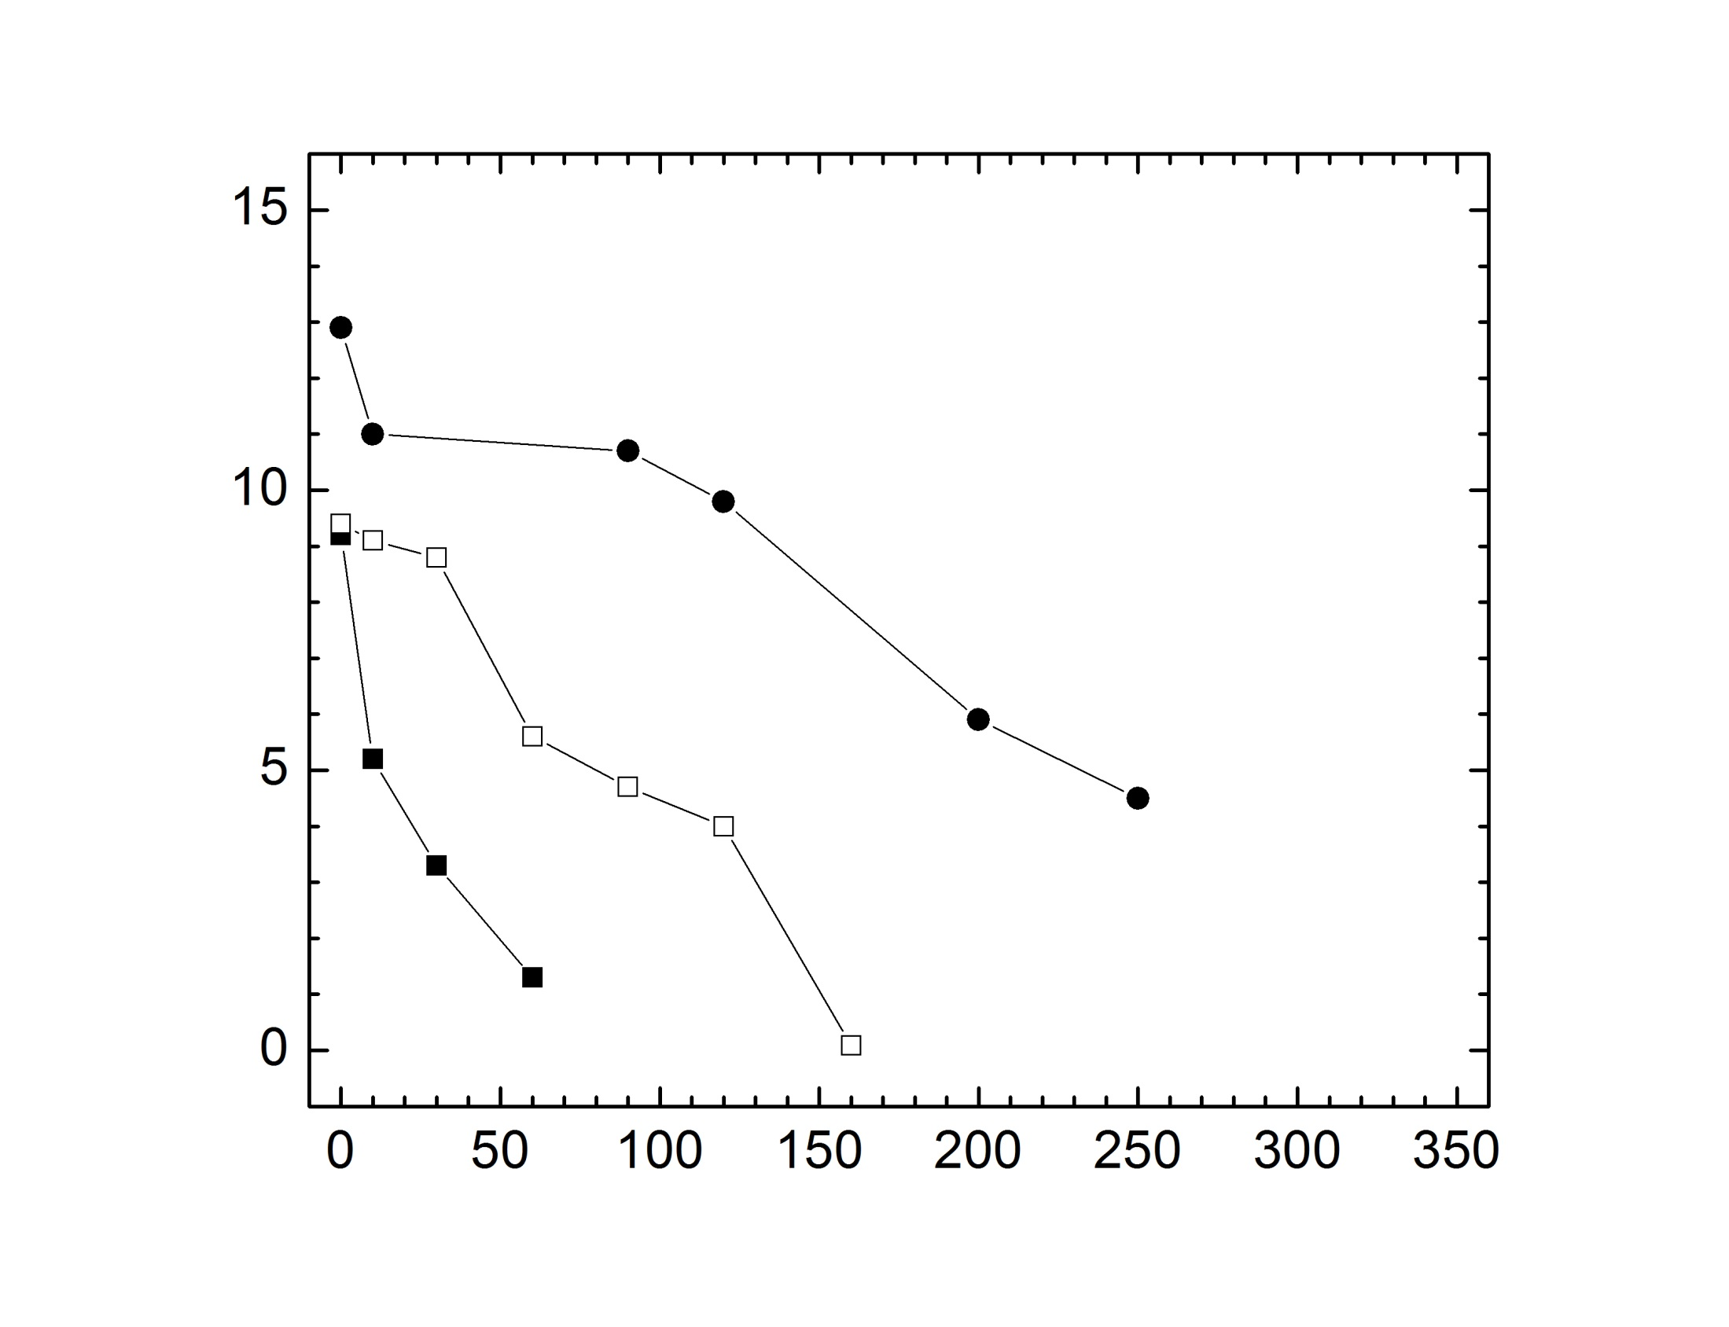
An additional 125 hour bake of the Al cell at +40°C above its run temperature cleans the lower AlGaAs barrier more.
Electron mobility (million cm²/V sec)
Thickness of AlGaAs barrier below quantum well (nm)

Slide 17
Another 90 hour bake of the Al cell at +80°C above its run temperature continues the AlGaAs cleanup.
Electron mobility (million cm²/V sec)
Thickness of AlGaAs barrier below quantum well (nm)

Slide 18
These experiments show:
The GaAs Q-well becomes contaminated by impurities from the AlGaAs barrier located underneath it.
As the thickness of the lower barrier increases, the mobility falls rapidly, suggesting the impurities are moving through the AlGaAs layer toward the GaAs Q-well.
An offline bake of only the Al-cell reduces the mobility fall-off, implying Al-cell impurities are causing the effect.

Slide 19
Proposed MBE Surface-Segregation model of the effect:
Impurities outgas from the Al-cell, and combine with Al-atoms in the growing AlGaAs layer, causing it to become impurity-contaminated.
Impurities compete for lattice-sites against the more aggressive Al or Ga atoms. This causes the impurities to delay incorporation in the AlGaAs lattice relative to Al or Ga. The result is a net impurity-drift in the direction of MBE-growth. This effect is called MBE-Surface-Segregation.
After the AlGaAs layer is complete, growth of GaAs begins, and the impurities compete for lattice sites only against Ga atoms. They thus incorporate more readily in the GaAs channel where they strongly degrade the mobility.
Secondary Ion Mass Spectrometry (SIMS) and Superlattice barrier experiments both support this Surface-Segregation model.

Slide 20
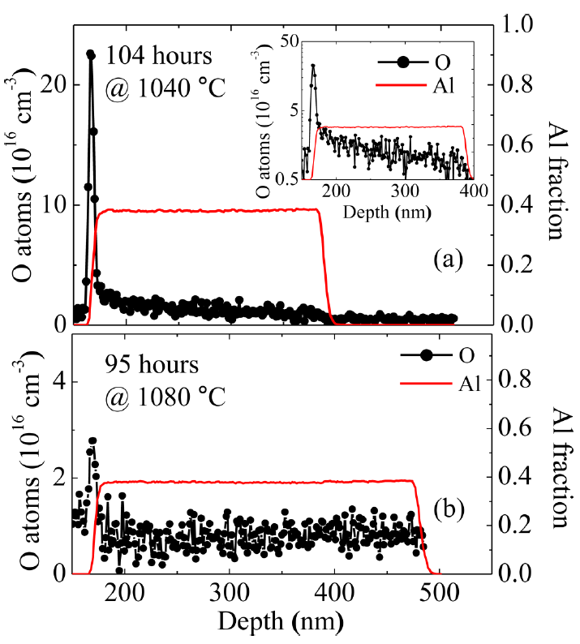
In SIMS (Secondary Ion Mass Spectrometry) experiments, we see the Surface-Segregation of Oxygen in our AlGaAs.
SIMS
MBE growth direction
GaAs
AlGaAs
GaAs
beam
Oxygen atoms accumulate in the growing AlGaAs. They follow the moving MBE-growth-front like a snowplow.
The huge oxygen signal in the GaAs cap layer occurs because the oxygen now competes only with Ga atoms for lattice sites.
Oxygen atoms (10¹⁶/cm³)
Al-fraction
Al-signal
Al-cell bake
Oxygen atoms (10¹⁶/cm³)
Al-signal
Al-fraction
The 1080⁰C bake plot confirms that the oxygen level is lowered by a long offline Al-cell bake.

Slide 21
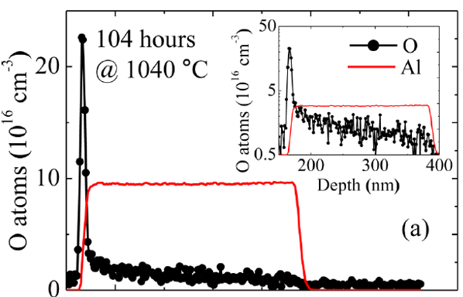
Why not use the MBE Surface-Segregation effect, to infer the impurity content of the AlGaAs.
Idea!
SIMS shows MBE-AlGaAs collects oxygen over its 400nm thickness, then dumps part of it into 10nm of GaAs. That is a ~ X40 impurity-concentration-gain.
Another huge sensitivity-gain comes from the sensitivity of 2D systems to charged-channel-impurities.
We know adding 10¹⁵/cm³ charged-channel impurities lowers the transport mobility of an ultra-clean Q-well to only 1 million cm²/V s.
Thus 2.5 x 10¹³/cm³ charged impurities in the 400nm wide AlGaAs lower barrier would drop the mobility of a clean Q-well from > 15 million to 1 million cm²/Vs.

Slide 22
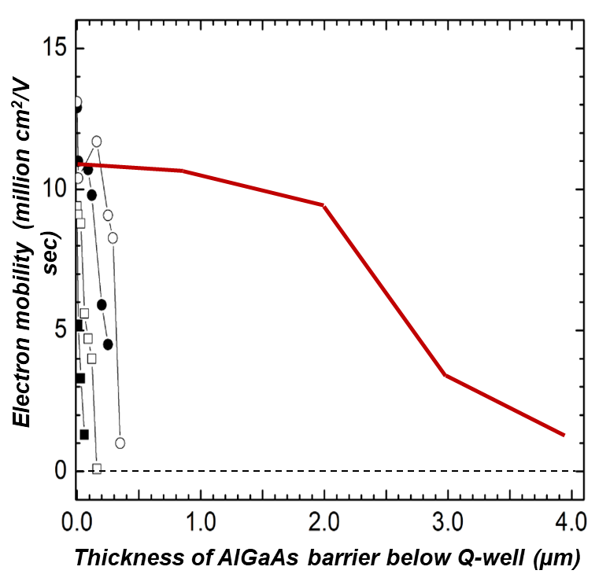
Here (by further Al-cell baking) we have extended the thickness of the lower AlGaAs barrier by a factor of ten from 400nm to 4µm.
(The data shown before are now compressed at the left side of the plot.)
MBE surface-segregation is clearly still operative for 4µ thick AlGaAs films.
Thickness where mobility falls to half
its zero-thickness value
Impurities are now swept from the entire 4µm-thick lower barrier and concentrated into 10nm of the GaAs channel.
With micron thick-lower barriers our impurity-sensitivity is improved by another factor of 10 to about 3 x 10¹² impurities/cm³ .
Key Conclusion:
Higher AlGaAs purity is implied by mobility-half-points linked to thicker lower barriers.

Slide 23
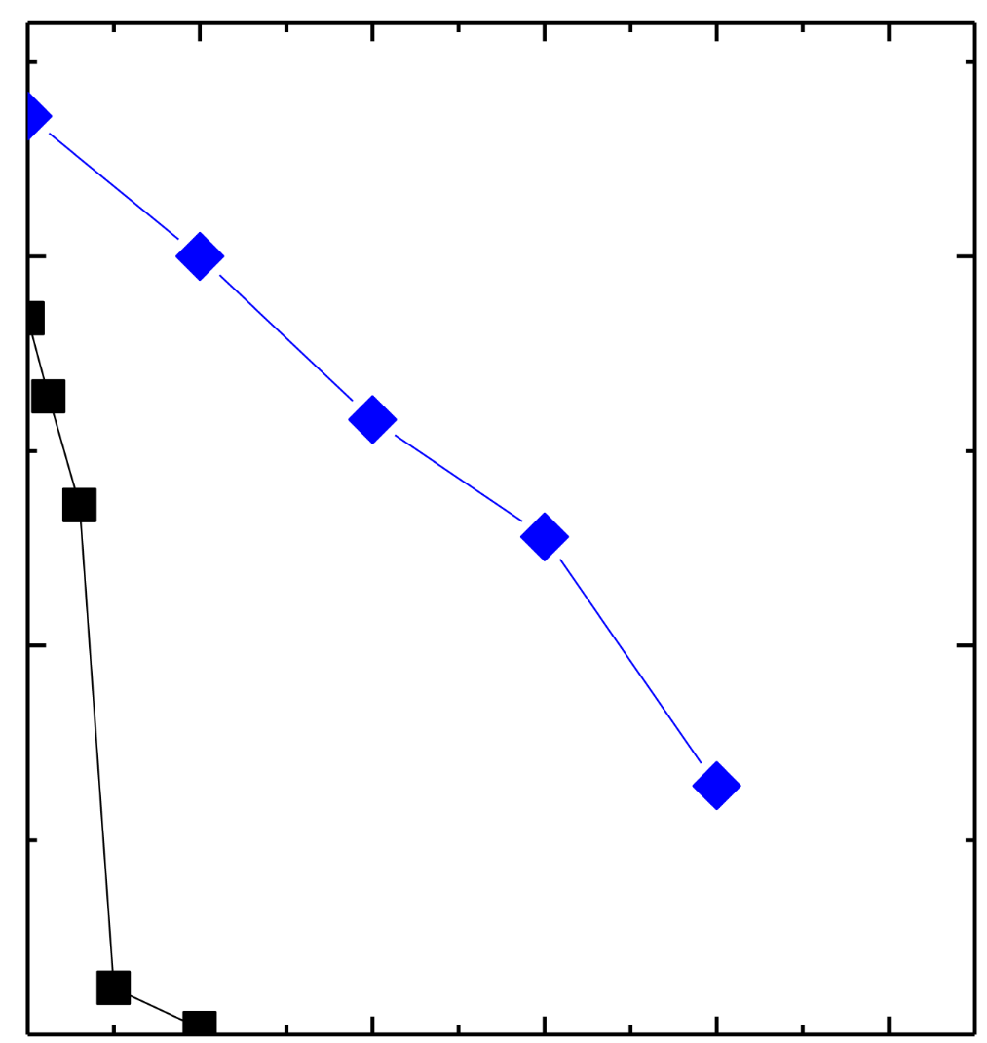
These nice results open-up possiblitited cool new experiment:
Measuring the impurities in the lower AlGaAs barrier versus the level of cryo-pumping in the MBE chamber.
In our normal level of cryo-pumping we use 4 external cryopumps. We will either take away cryo-pumping, or add cryo-pumping, and compare that to this condition.
10
Q-well mobility (millions cm²/V s)
4 cryopumps
5
3.1µm
With 4 external cryopumps a 3.1µm AlGaAs lower barrier thickness causes the Q-well mobility to fall to exactly half of its zero-thickness value.
3.1µm
0
1
2
3
4
5
Thickness of lower AlGaAs barrier (µm)

Slide 24
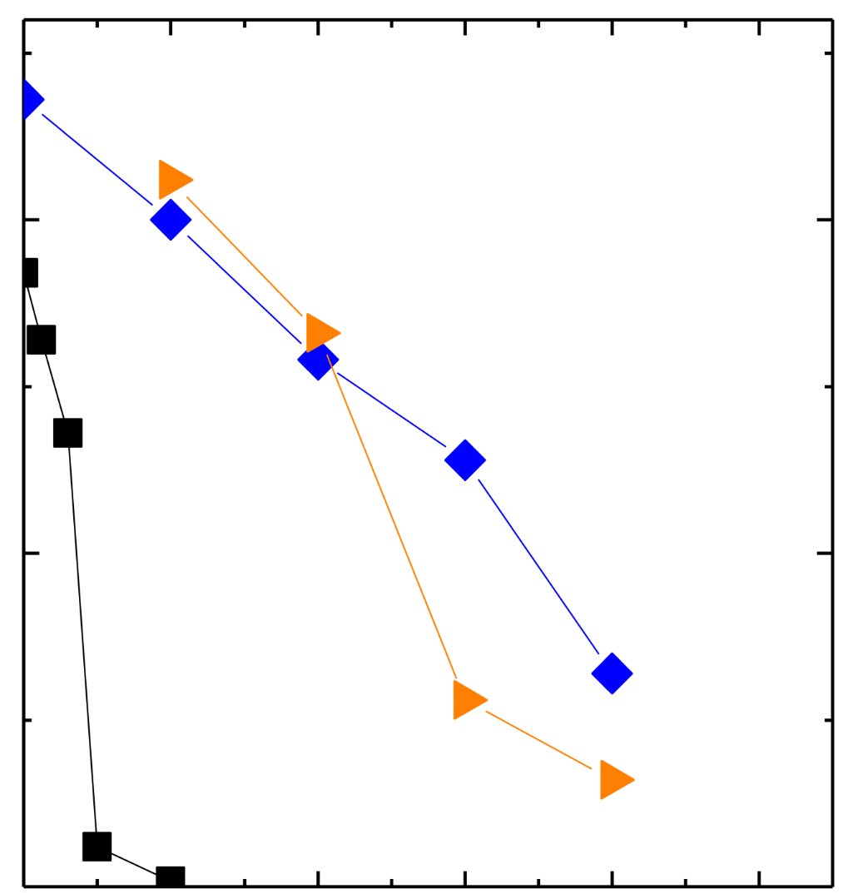
Contamination of the MBE AlGaAs barrier material by the MBE vacuum-ambient.
Using 4 cryopumps it takes a 3.1µm AlGaAs barrier to cause the mobility to fall by half.
10
Using 1 cryopump, it takes only a 2.4µm AlGaAs barrier to cause the mobility to fall by half.
Q-well mobility (millions cm²/V s)
4 cryopumps
5
3.1µm
2.4µm
This shows that pumping with 1 cryopump causes more impurity-contamination in the lower AlGaAs barrier than when we used 4 cryo-pumps.
1 cryopump
0
1
2
3
4
5
Thickness of lower AlGaAs barrier (µm)

Slide 25
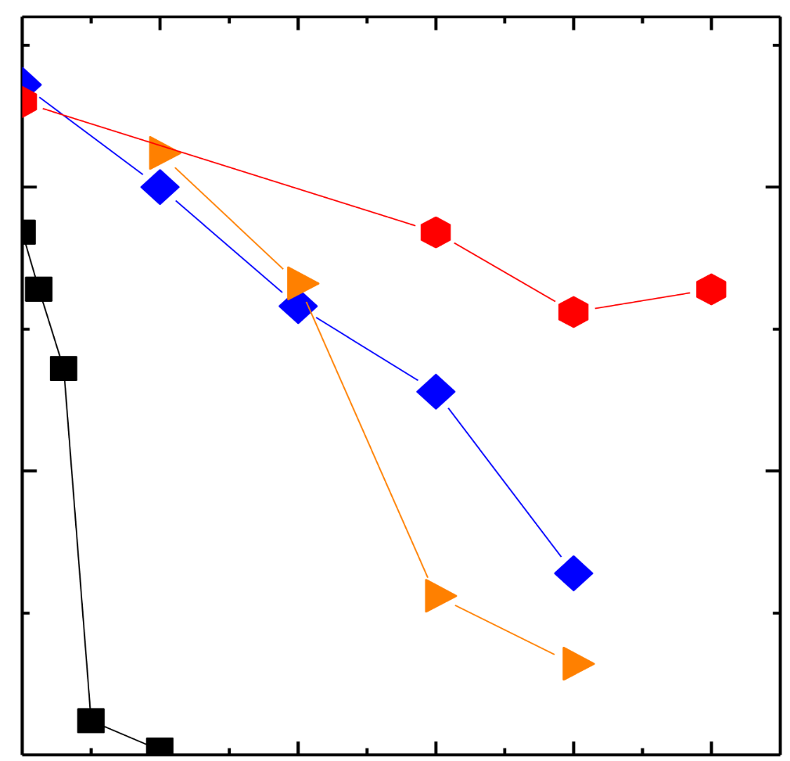
Contamination of the MBE AlGaAs barrier material by the MBE vacuum-ambient.
Using 4 cryopumps it takes a 3.1µm AlGaAs barrier to cause the mobility to fall by half.
18K cold-plates with 4 cryopumps
10
Using 1 cryopump, it takes only a 2.4µm AlGaAs barrier to cause the mobility to fall by half.
Q-well mobility (millions cm²/V s)
5
4 cryopumps
3.1µm
5.9µm
Using 4 cryo-pumps plus the 18K cold-plates causes the mobility half-mobility point to rise to 5.9µm.
2.4µm
1 cryopump
0
1
2
3
4
5
Thickness of lower AlGaAs barrier (µm)
This shows that using the 18K cold-plate improves the AlGaAs lower-barrier purity by about a factor of two!

Slide 26
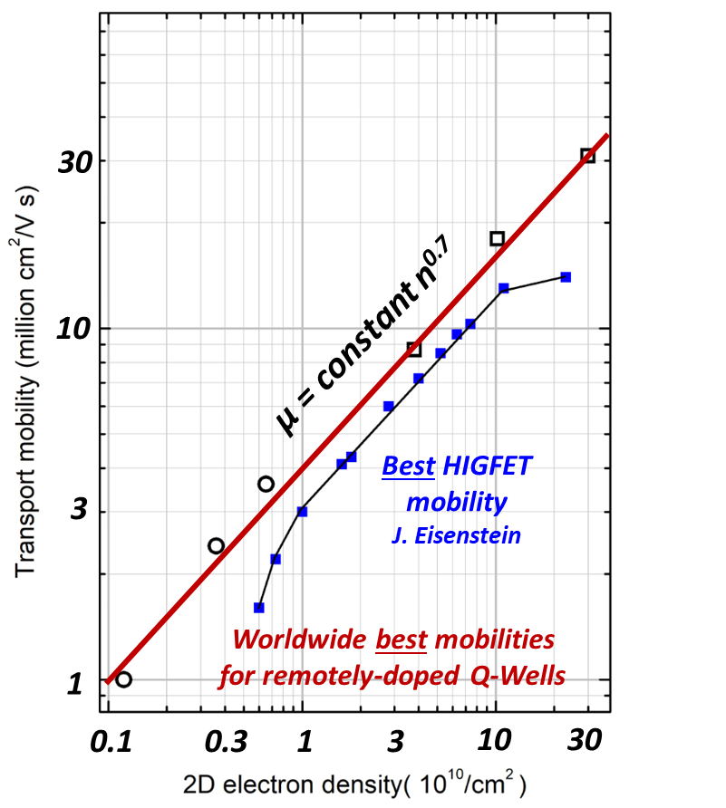
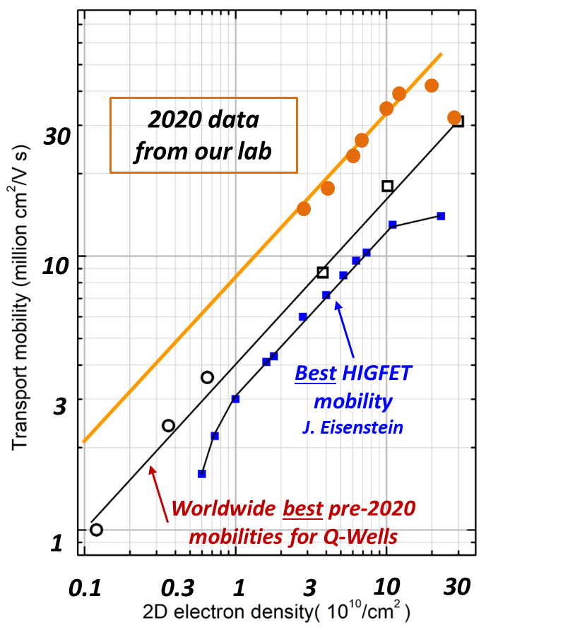
In the past 3 years we used these insights to double the electron mobility and overall quality of our GaAs quantum wells.
Here the red line is representative of the best GaAs mobilities achieved worldwide
up to the year 2019.
Our lab’s 2020 mobility data are twice as high as all older mobility values at low electron densities.
The mobility/density slope of the new data is preserved at n^{0.7}. This is expected. Background Impurities are the limiting factor at these low densities, and they were reduced by a factor of two.

Slide 27
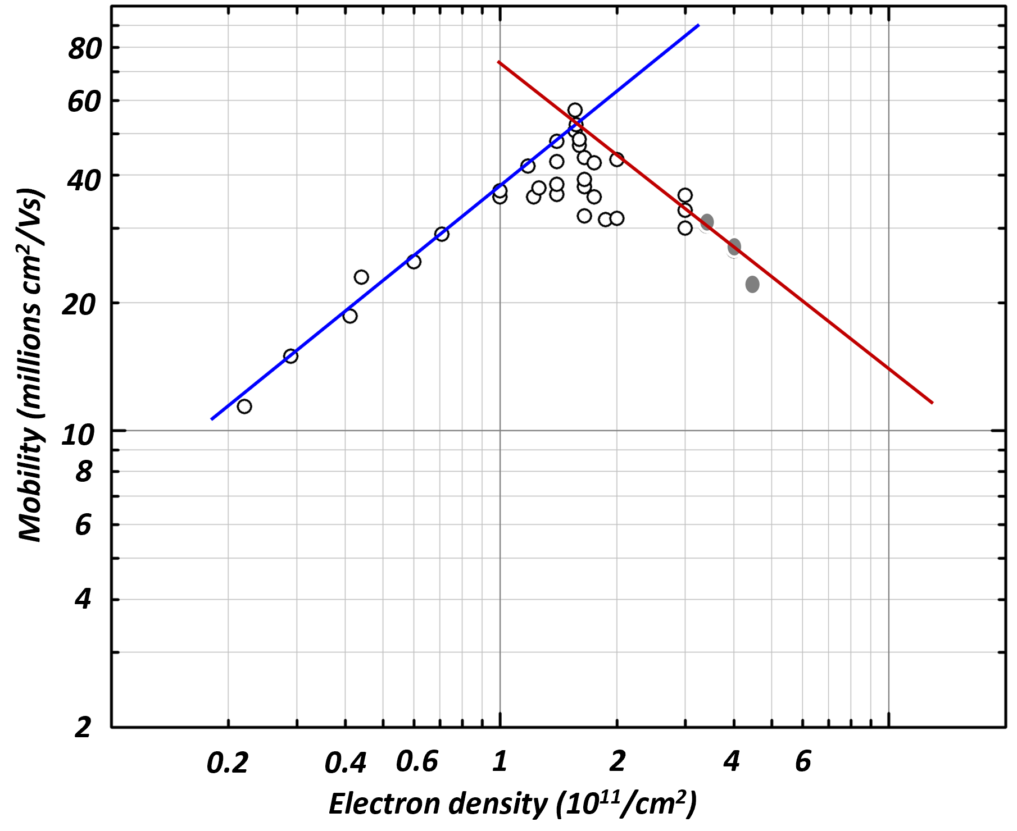
Here is a mobility data-set spanning the electron density range 2x10¹⁰/cm² to 5x10¹¹/cm².
At low densities the mobility is limited by background impurities going as the blue line,
µ = constant n^{0.7}.
At high densities we find different limits are imposed at the red line.
Background impurities
Si-dopant scattering and
Interface roughness scattering
Where the blue and red lines cross we reported a new electron mobility record of 57 million cm²/Vs at 1.5x10¹¹/cm².
Phys. Rev. B 106, 075134 (2022)

Slide 28
In 2023 after setting fresh mobility records for low density 2D-electrons in GaAs quantum wells, it was a good time to think about 2D-hole mobilities.
Holes had long been neglected by the magneto-transport and MBE communities, and there was a theoretical puzzle:
Until recently the highest hole mobility was only 2 million cm²/Vs.
This is starkly lower than the 57 million we reported for electrons in 2022.
At low densities the mobilities of holes and electrons are both limited by background impurities, and these should be the same for holes and electrons.
Low density holes in GaAs have an effective mass six times higher than electrons, but that would not nearly account for a huge mobility difference.
Over the past year we did a systematic study to improve our understanding of holes in GaAs, and set a new mobility record of 18 million cm²/Vs for holes at 30 mK.
Now the transport mobilities of holes and electrons are approximately equivalent after accounting for their effective mass difference.

Slide 29
Here we remind you what the physics community is doing with our ultra high quality GaAs material.
A very active community uses excitons in quantum wells that are located in Distributed Bragg Reflecting optical cavities. This structure can form polaritons which can be induced to undergo Bose-Einstein-Condensation.
These folks need super-high Q-factor cavities.
Our Q-factors are 300,000 which is 6-times that of material from other growers.
A related community studies exciton physics in various quantum structures in our material. Some are attempting to observe Bose-Einstein-Condensation of excitons, which so far has not been observed.
Another large and active community is engaged in Quantum Hall physics, or looking generally for new physics in low dimensional systems using either magneto-transport or optical probes.
Perhaps the most interesting collaborator-community uses our material to build quantum interferometers. These folks build actual nano-devices that can deeply probe into the intricacies of quantum entanglement.
Quantum interferometer devices are sensitive to all forms of nano-disorder. Our very best GaAs material is just barely good enough to have launched the new game of quantum interferometry.

Slide 30
Presently we can see quantum interference only in nano-sized interferometer loops.
V_{side}
Consider the interferometer above made by Willett at Bell Labs from 30 million-mobility GaAs material. We want to see quantum interference between the Black and Red dashed particle paths.
At 30 million the mean free path for large-angle scattering is 300µm.
But for any scattering, at any angle, the mean free path is only 2 to 3 µm.
Thus, to see quantum interference, the red dashed path must not exceed 2 to 3 µm.
Bob Willett does see quantum interference signals in tiny interferometer loops in our material. And these signals hint at exciting Non-Abelian quasiparticle statistics.
Quantum interferometry is an emerging new field that demands the highest purity GaAs.

